Slide 1



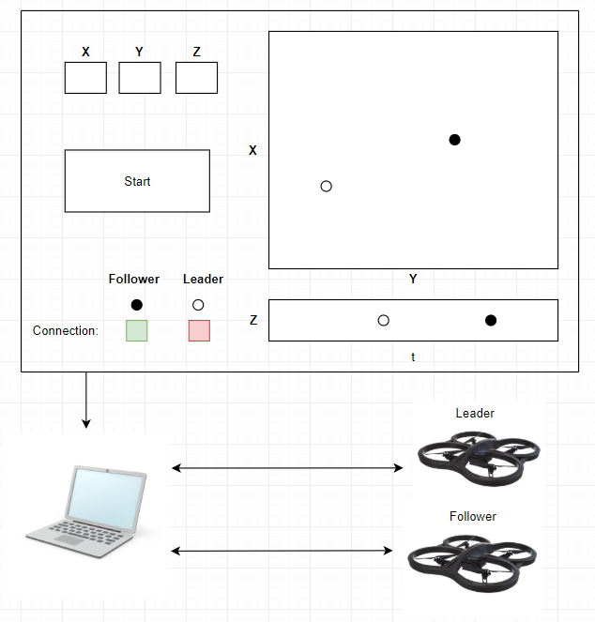
Background
System Diagram
Progress
In our project, we focus on having an autonomous follower drone to follow a primary leader drone. The project would help improve military technology by exploring ways to allow a single drone to communicate or control multiple autonomous drones.
Acquired drone that can be hacked
In progress of developing base station GUI that displays retrieved GPS data and controls follower drone
Implementing method to hack drone’s video and control
Milestones
References
Create GUI Interface
Control Parrot AR Drone with laptop with code in C
Retrieve Parrot AR Drone GPS data on the laptop
Display retrieved GPS data and connection data on the GUI
[1] P. Bouman, et al. “Dynamic Programming Approaches for the Traveling Salesman Problem with Drone.” Networks, vol. 72, no. 4, 2018, pp. 528–542.
[2] L. Mottola et al. “Team-Level Programming of Drone Sensor Networks.” Proceedings of the 12th ACM Conference on Embedded Network Sensor Systems - SenSys '14, 2014.
Materials
Parrot AR. Drone 2.0
Laptop
GPS Module (2)

